Slide 1


Universidad Autónoma de Baja California
Language School
Evaluación educativa
Group: 115
Doctora Lopez Gaspar Icela
Evaluación para el aprendizaje
Assessing Writting
by:
Arreola Montoya Roberto
Jueves, 14 de noviembre 2019

Slide 2
Assessing Writing

Slide 3
INDEX
  Genres of written language.
  Types of writing performance.
  Micro and macro-skills of writing.
  Designing assessment tasks.
              Intensive controlled writing
              Dictation and Dicto-comp
              Grammatical Transformation Tasks
              Picture-cued tasks
              Vocabulary Assessment tasks
              Ordering tasks
              Short answers and sentence completion tasks
              Paragraph construction tasks
              Scoring methods for responsive writing and extensive writing

Slide 4



Genres of written language
Academic writing
Job related writing
Personal writing
General subject reports essays and papers
Messages, memos, letters and manuals

Slide 5
Types of writing performance.
Imitative
Basic tasks of writing letters, words, punctuation, and very brief sentences.
Intensive
Production of apropiate vocabulary within a context, colocations and idioms, and correct grammatical features.
Responsive
Here assessment tasks require learners to perform at a limited discourse level conecting sentences into a paragraph and creating a logically connected sequence.
Responsive
Implies successful management of all the processes and strategies of writing for all purposes.

Slide 6
Micro- and Macroskills of Writing
Microskills
Produce writing at an efficient rate of speed, use acceptable gramatical systems and use cohesive devices in written discourse.
Macroskills
Apropiateltely acomplish the comunicative functions of written texts, distinguis between literal and implied meanings when writing, develop and use a battery of writing strategies.

Slide 7
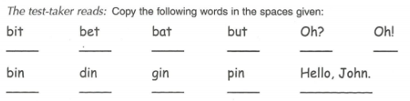
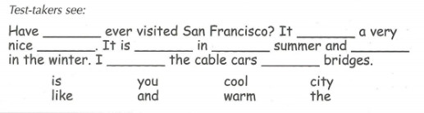
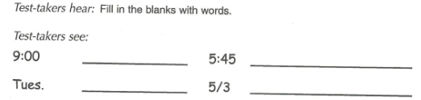
Designing assessment tasks:
Imitative writing
                - Copying
                -Listening cloze selection tasks
- Converting numbers to words

Slide 8
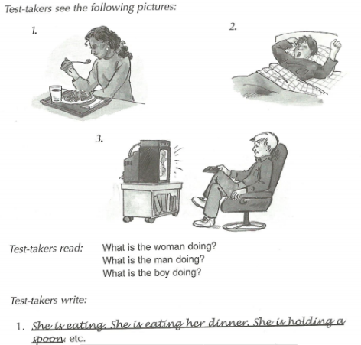
Designing Assessment tasks: intensive (controled) writing
- Dictation
- Grammatical transformation paragraph
- Picture-Cued tasks.

Slide 9
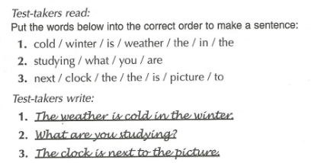
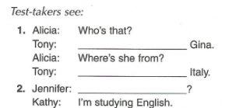
- Ordering tasks - Short answer and sentence completion task

Slide 10
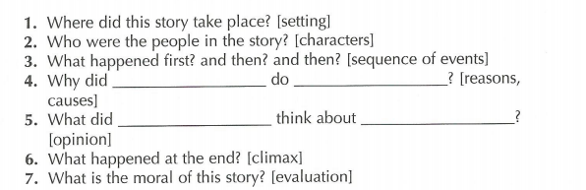
Designing Assessment Tasks: Responsive and Extensive writting
Paraphrasing
Guided Question and Answer
Paragraph Construction Tasks

Slide 11

Thank You
Contact information
Roberto.arreola.Montoya@uabc.edu.mx

Slide 12
References
Brown, D. (2003). LANGUAGE ASSESSMENT: Principles and Classroom Practices. San Francisco, California: Longman.

